Slide 1


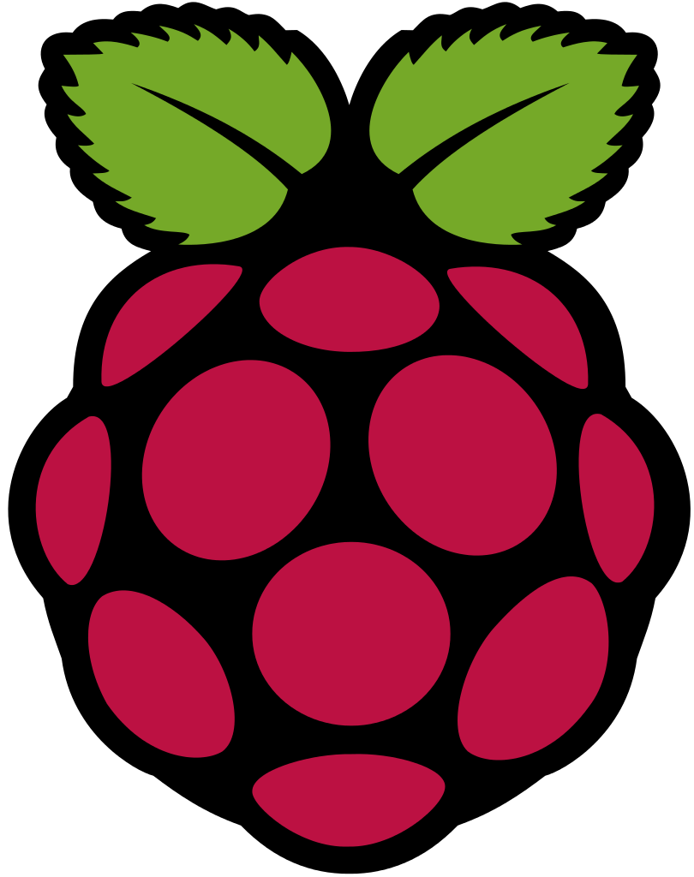
Preparing Raspberry Pi for First Use.
Setting up noobs and Raspberry pi for first use.
Complete Guide for all the DIY and know hows.
Copyright Robosapiens Technology Pvt. Ltd.

Slide 2
Preparing NOOBS for first use
NOOBS:- It is a Linux Debian image made exclusively for Raspberry Pi.
The OS that you get by default is Raspbian.
NOOBS means: New Out OF the Box.
Designed specifically for the Raspberry Pi platform this is a completely hassle free operating system.
It is a free OS available from the Raspberry pi foundation
There are many other operating systems available for advanced users.
Copyright Robosapiens Technology Pvt. Ltd.

Slide 3
The online Download Source
Raspbian and other OS versions are available as free downloads online.
https://www.raspberrypi.org/downloads/
The link above lists many Operating Systems available.
Some of the Tested OS are:
NOOBS
Raspbian
Ubuntu Mate
Snappy Ubuntu Core
Windows 10 IOT core
OSMC
Openelec
Pinet
Risc OS
Copyright Robosapiens Technology Pvt. Ltd.

Slide 4
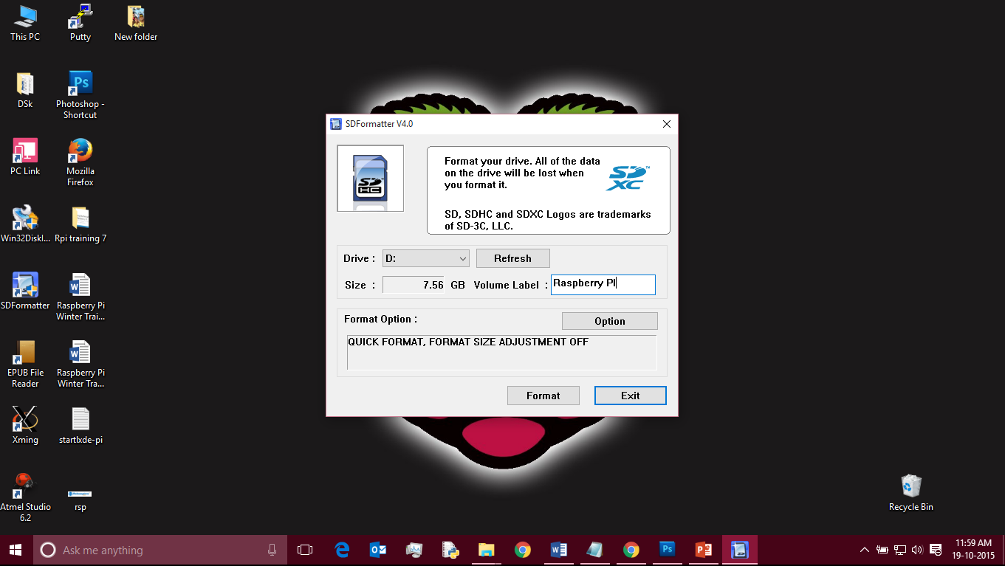
Formatting SD Card
Formatting the SD card is Done Via SD Formatter Software.
Copyright Robosapiens Technology Pvt. Ltd.

Slide 5
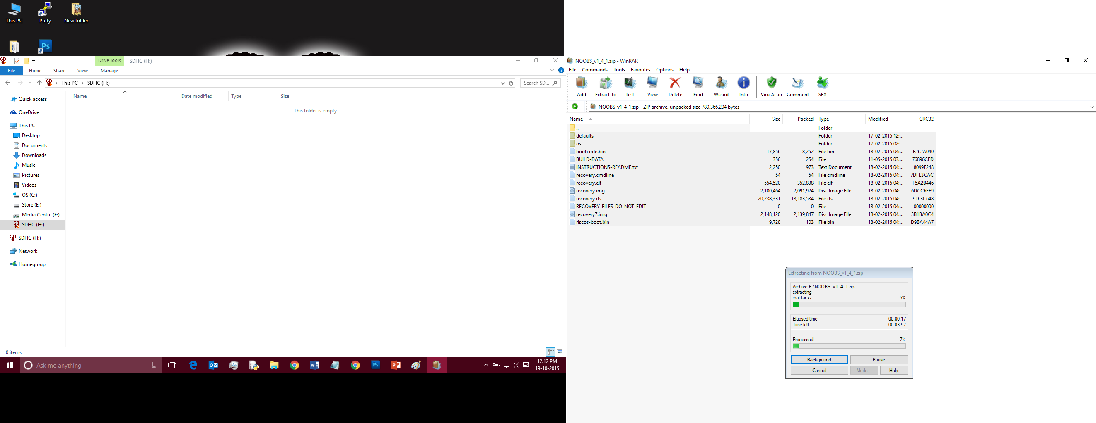
Copying NOOBS installation Files.
Copyright Robosapiens Technology Pvt. Ltd.

Slide 6
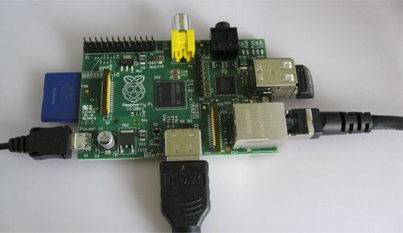
Connecting Raspberry Pi to peripherals
Copyright Robosapiens Technology Pvt. Ltd.

Slide 7
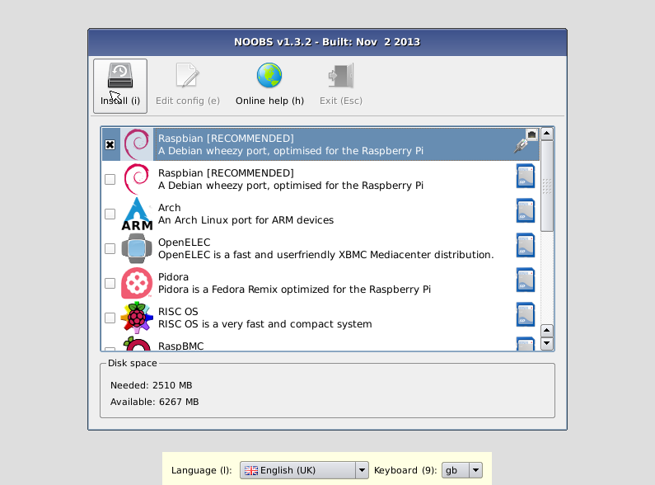
The First Boot Screen
Choose Raspbian from the list as rest are only download links.
The Setup will take from 20 to 40 minutes to complete.
Upon successful installation you will be greeted by the GUI of the Raspbian.
Copyright Robosapiens Technology Pvt. Ltd.

Slide 8
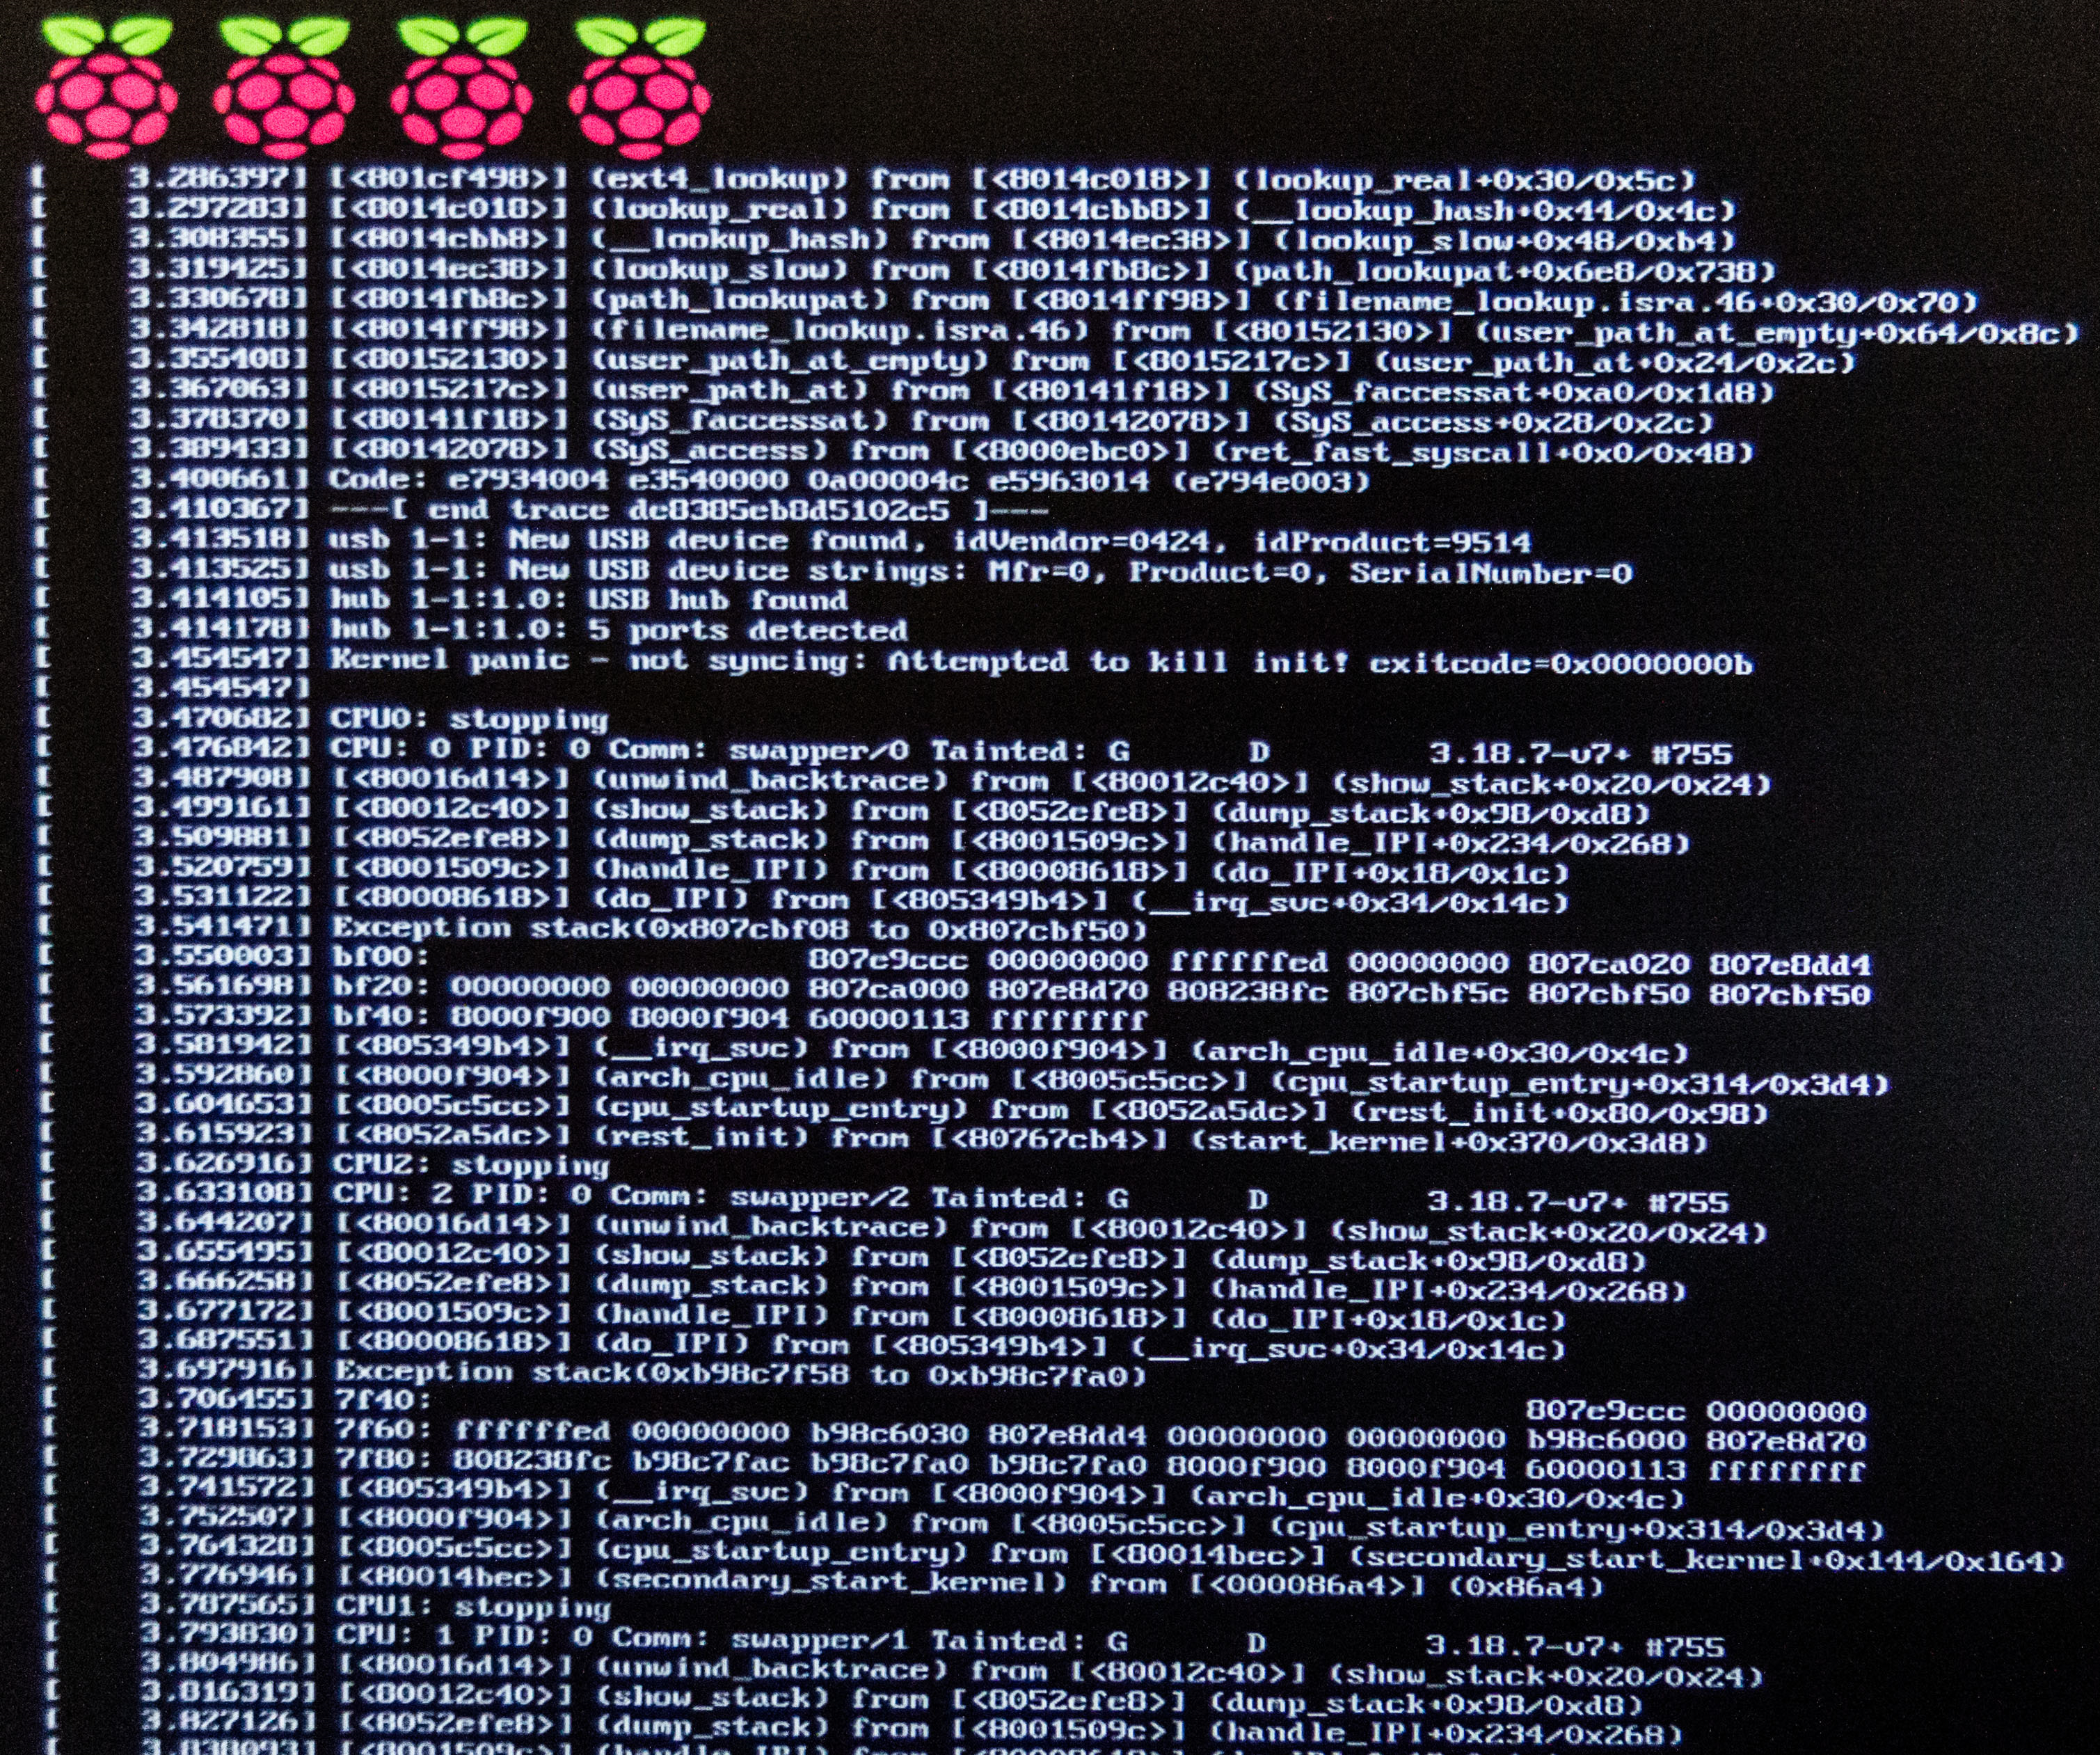
Raspbian Boot screen
The number of Raspberries on the top represents the number of cpu cores in the SoC of the Raspberry Pi
This particular is the Raspberry Pi 2’s boot screen.
Copyright Robosapiens Technology Pvt. Ltd.

Slide 9
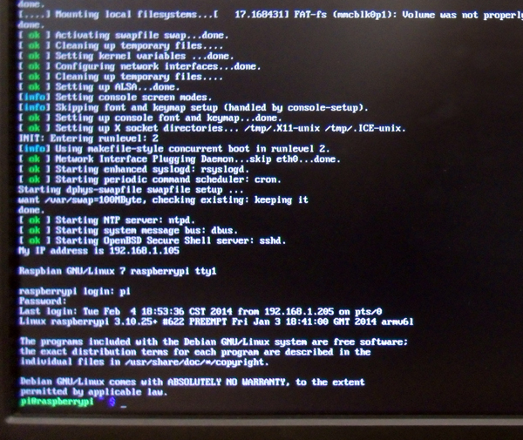
Login to your Raspberry Pi
The default Username for the Raspbian OS is: Pi
The default password is: raspberry
If the boot doesn’t ends up in gui, type startx to start the GUI of the Raspbian.
Copyright Robosapiens Technology Pvt. Ltd.

Slide 10
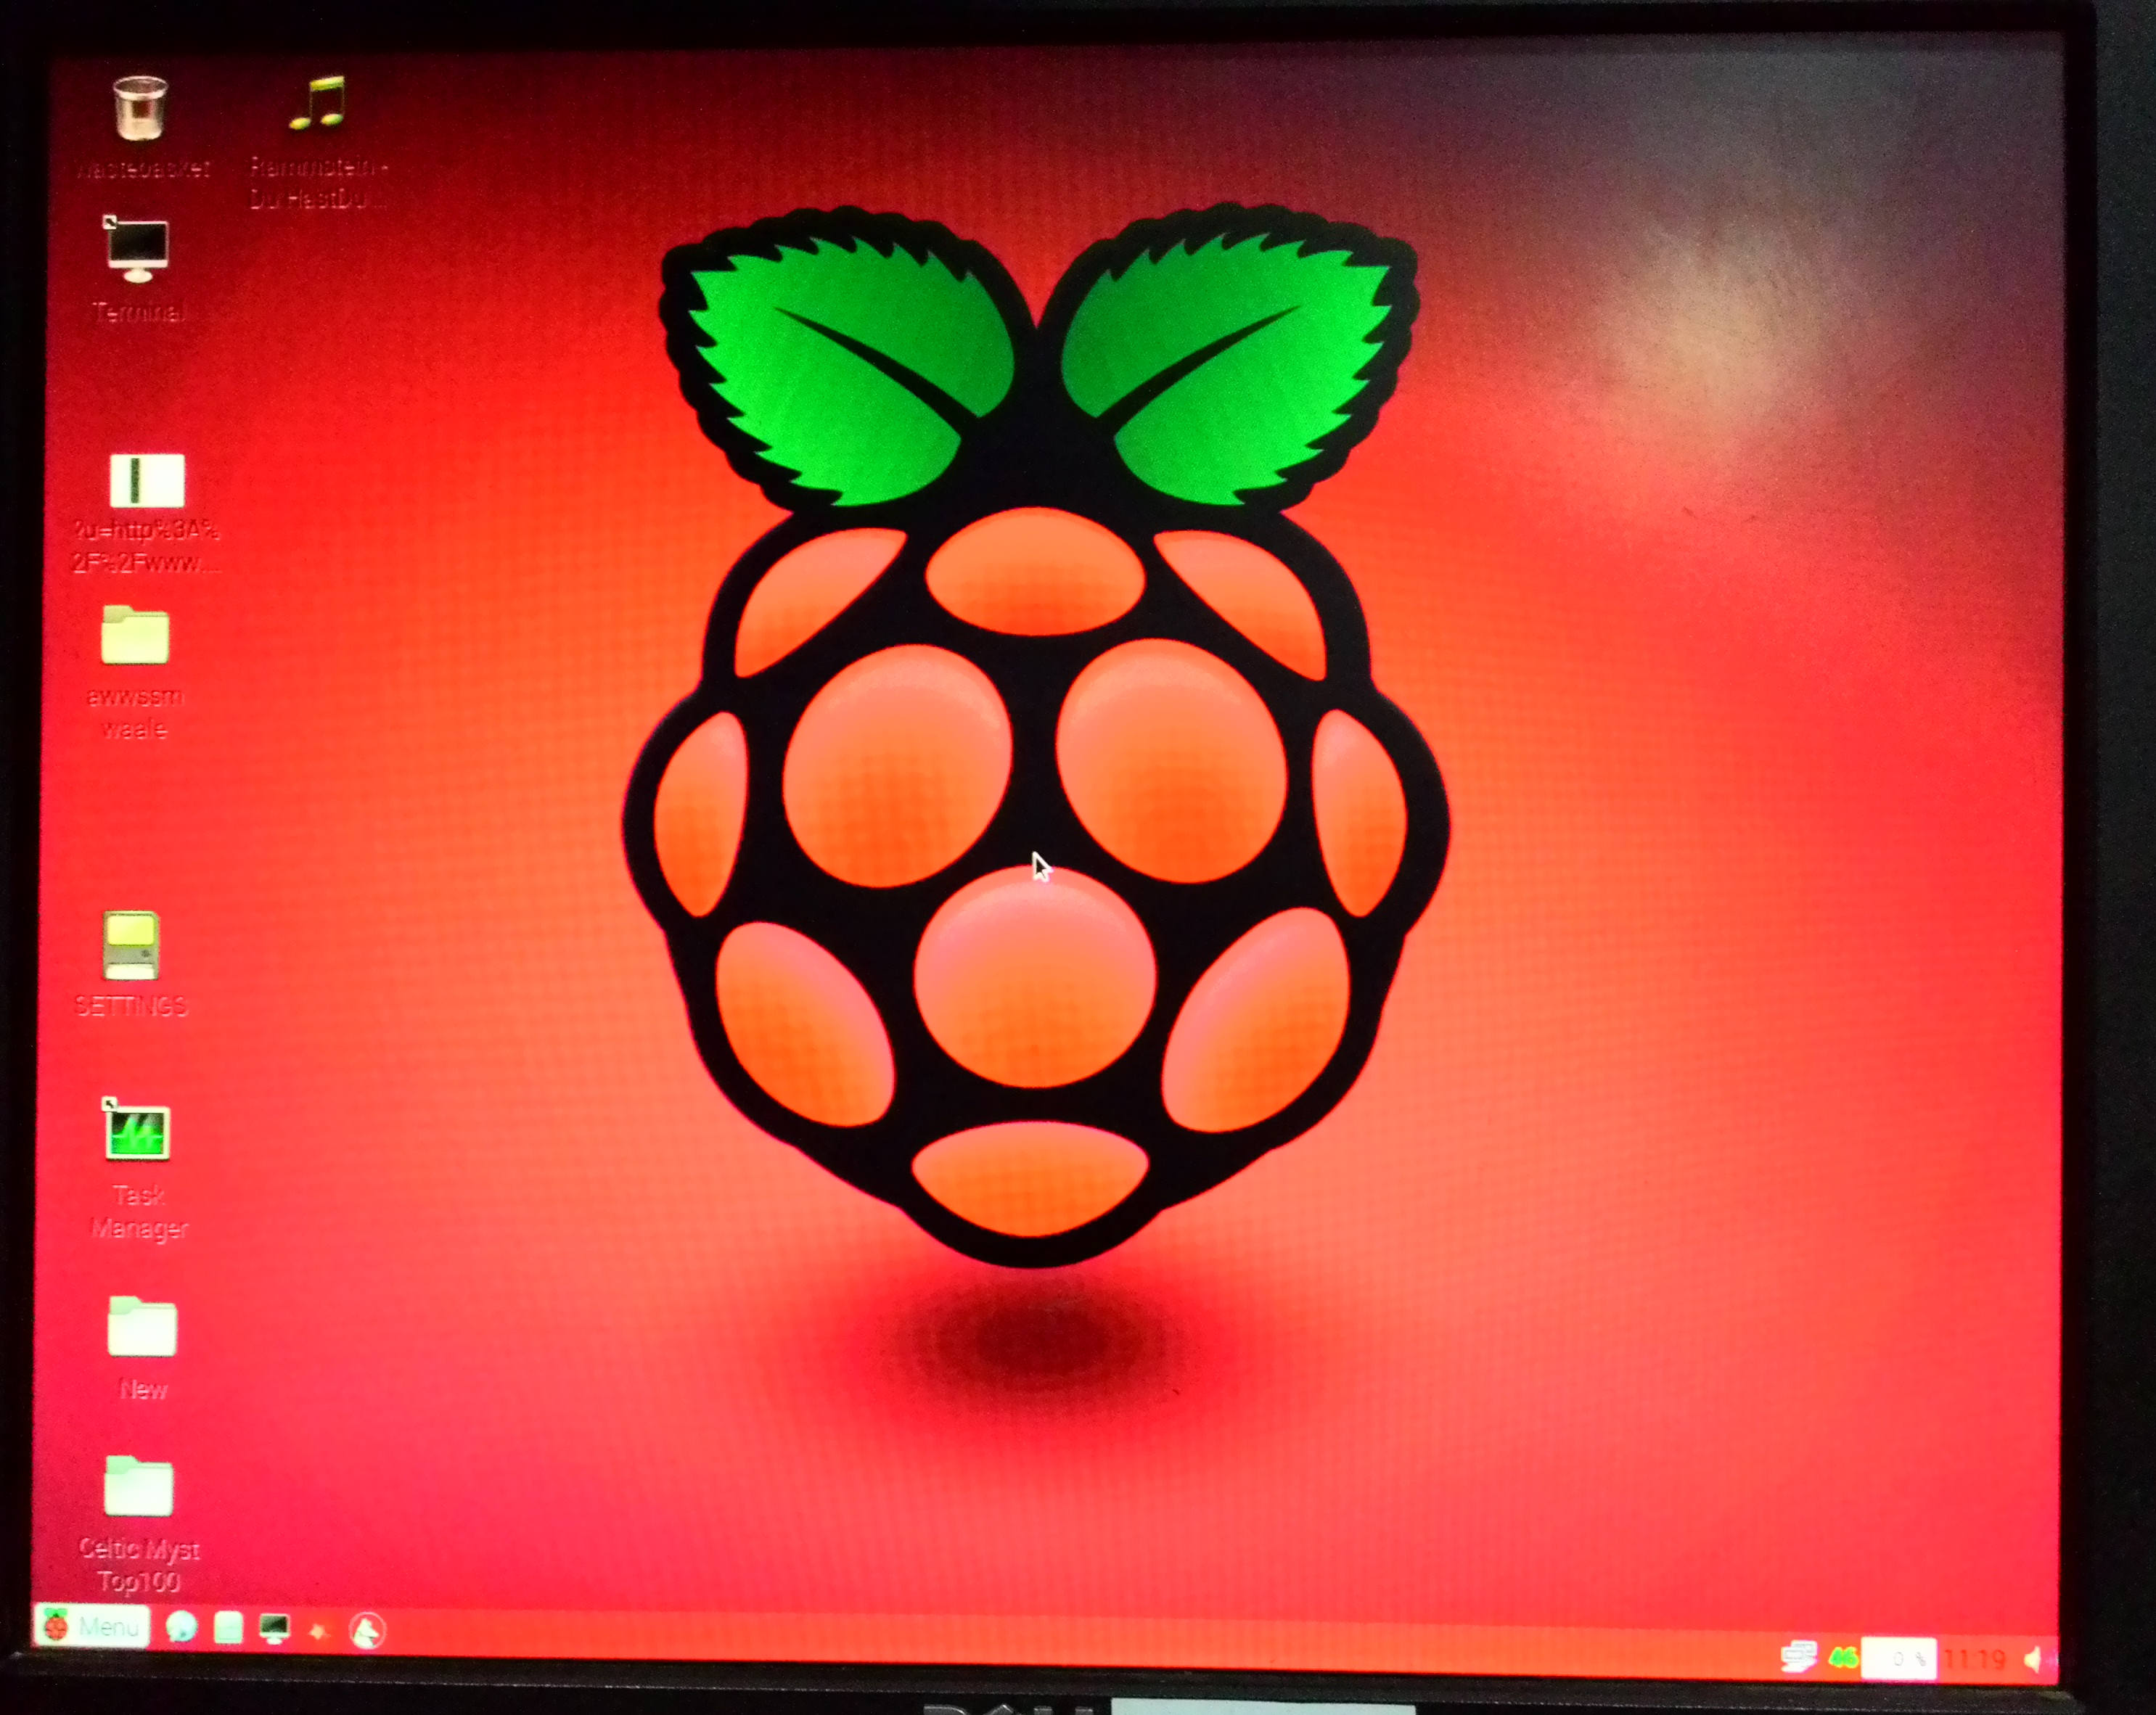
The Raspbian GUI
This is the Desktop GUI of the Raspbian after successful installation.
Note: this is no the default wallpaper. Multiple enhancements have been applied.
Copyright Robosapiens Technology Pvt. Ltd.

